Slide 1


Data Visualization through POWER BI
- Power BI dashboards

Slide 2

Session-IV Plan
Creation of Pie charts.
Slicers in power BI.
Simple dashboard .
Assessment
Summary and Interaction.

Slide 3
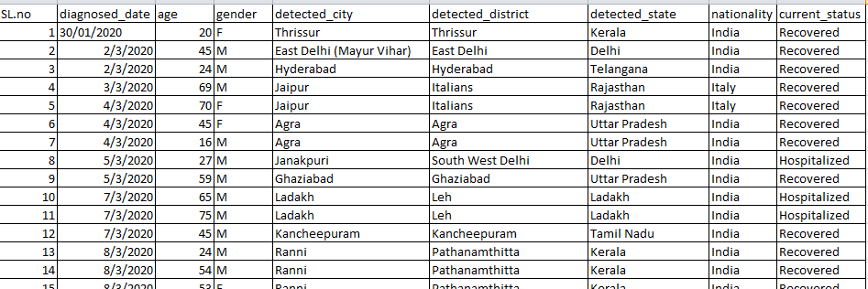
Pie charts and slicers in power BI
Load the data to power BI- This data have individual details of an person infected by COVID 19.

Slide 4
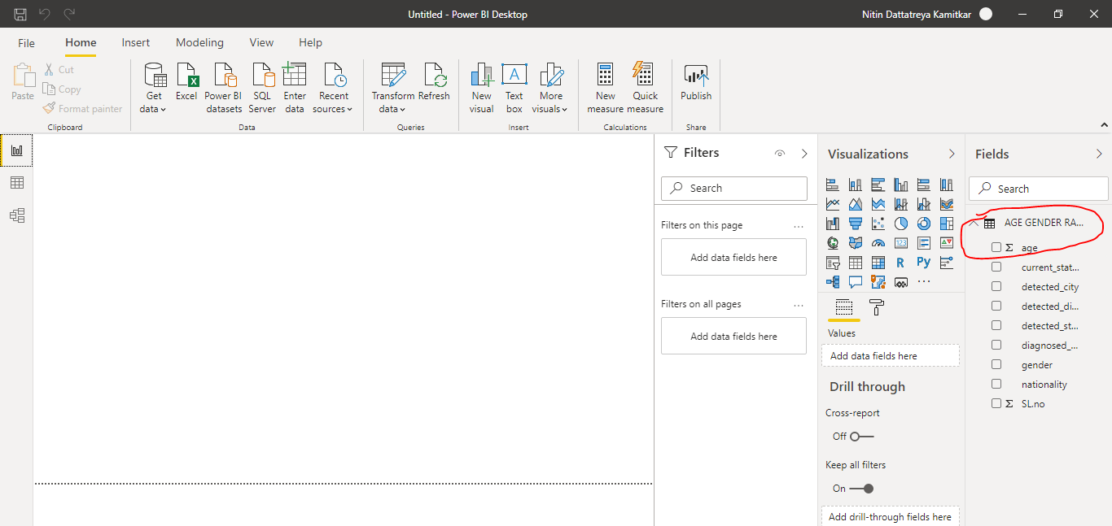
Check the data loaded properly or not.

Slide 5
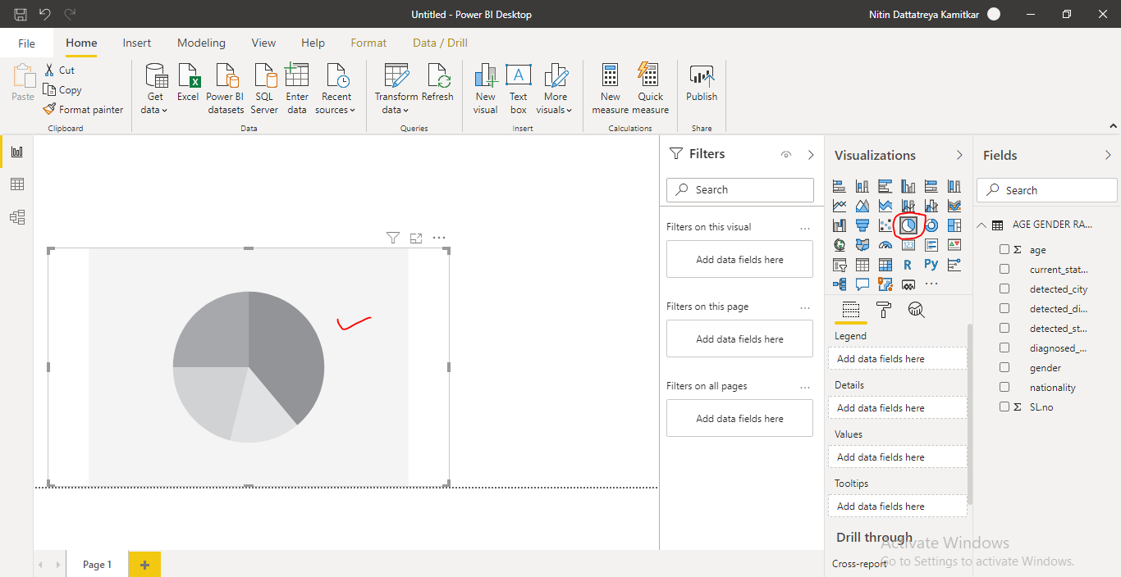
Here I want to visualize city wise count of male and female count.
Put pie chart

Slide 6
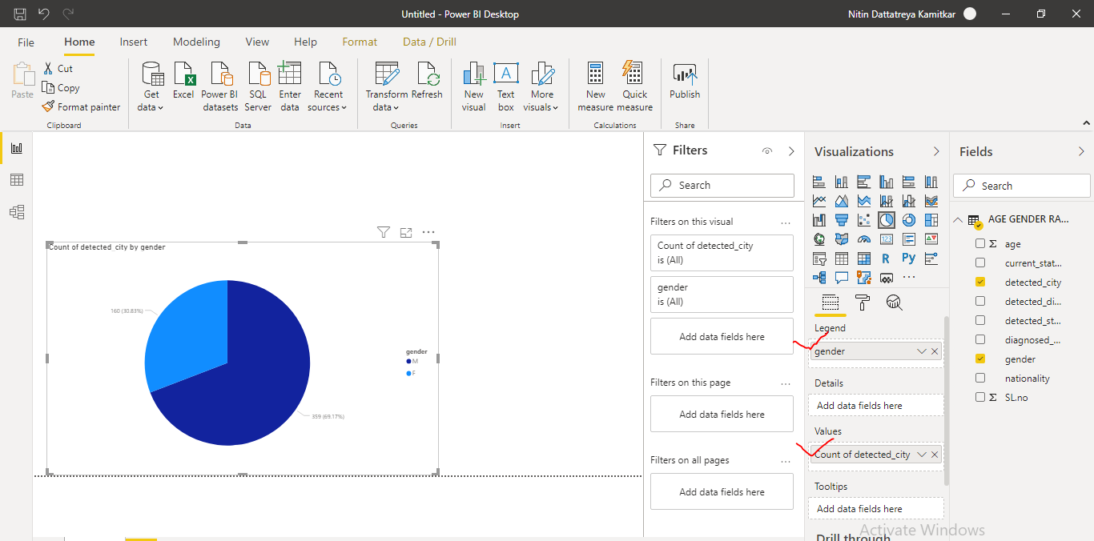
Now assign legend as gender and value as detected city. After doing this we got total count of male and females.

Slide 7
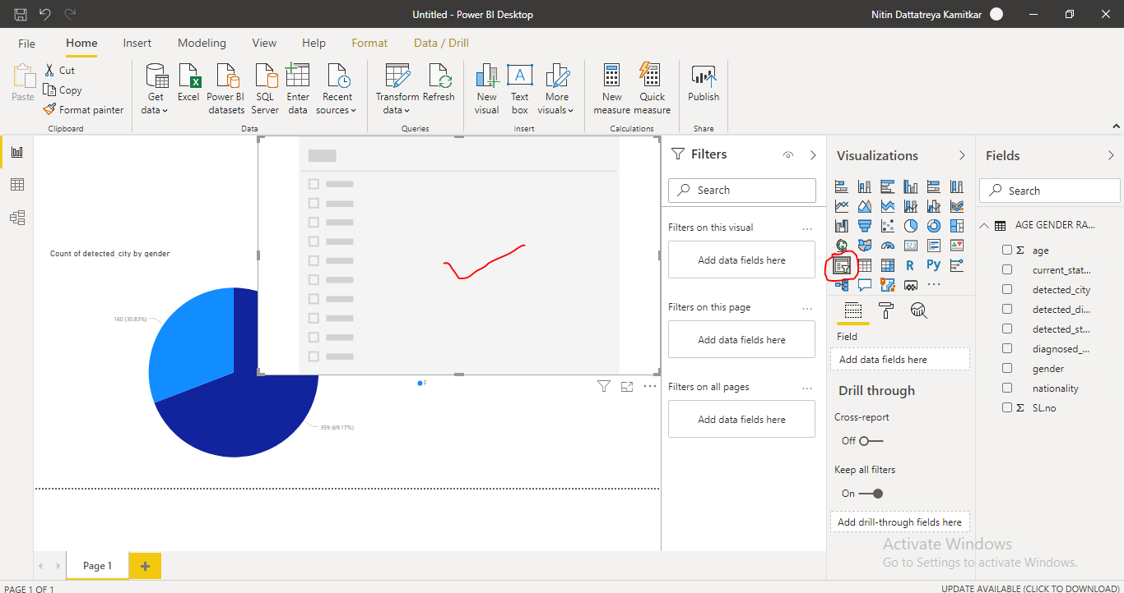
To check city wise lets use slicer option, Slicer will enable user to sort or filter packed data.
Click on blank page and select slicer.

Slide 8
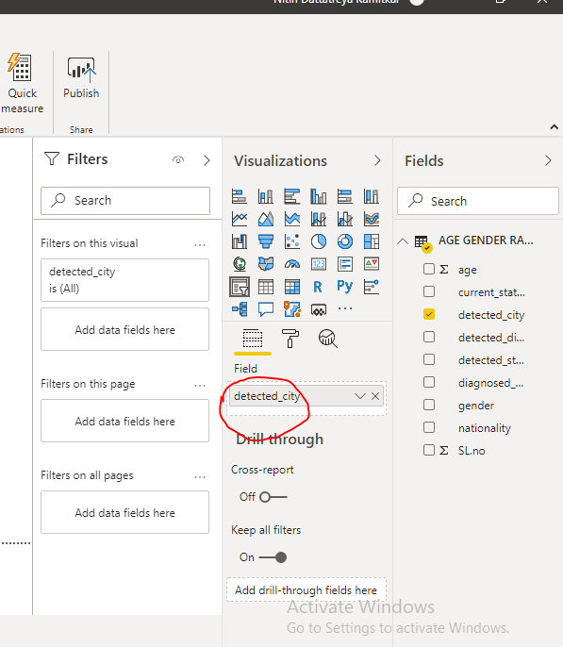
Assign field as detected city.

Slide 9
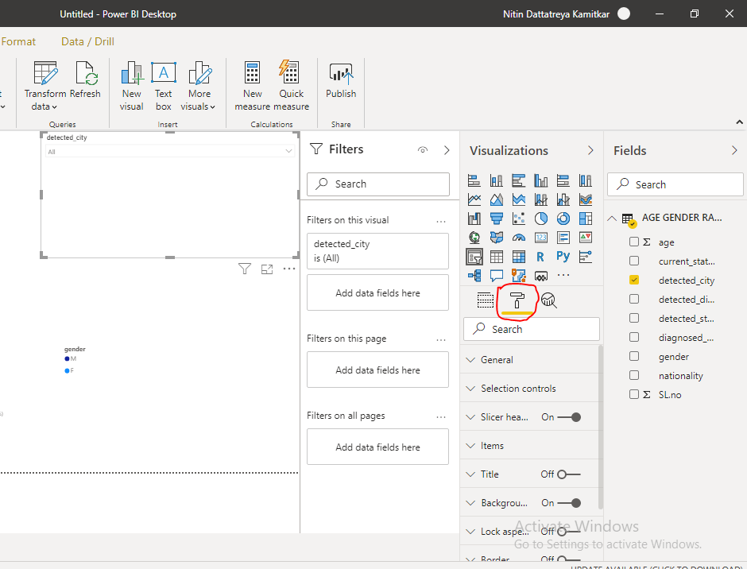
Edit the slicer as per convenient through format option.

Slide 10
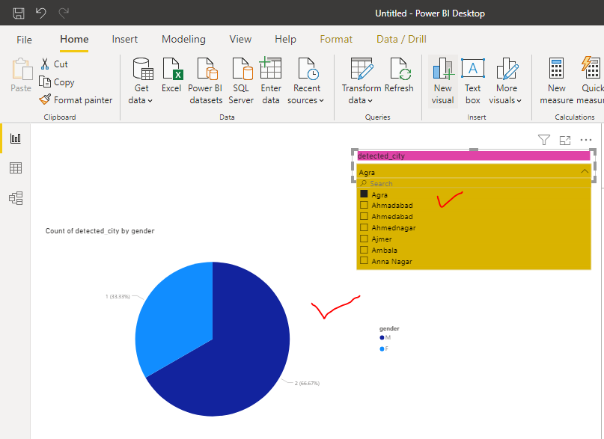
Now slicer is ready to act. We can find city wise gender count as shown .

Slide 11
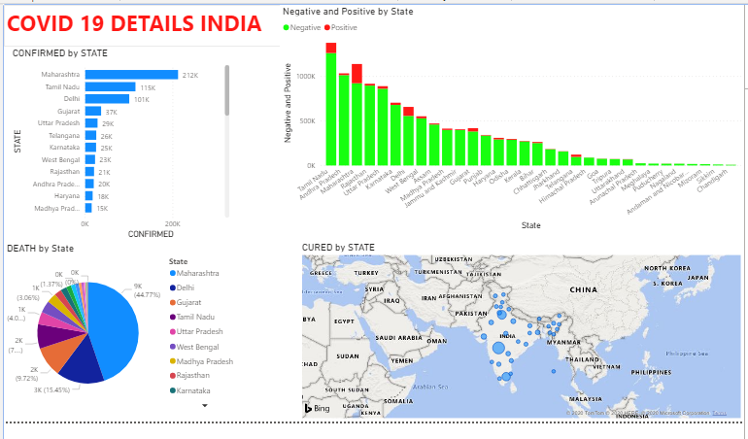
CREATING DASHBOARD IN POWER BI

Slide 12
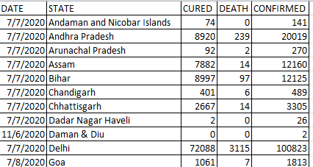
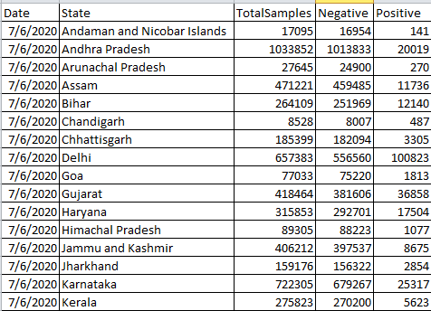
This dashboard is prepared with two separate excel data sheets having state wise cured , death , confirmed count and state wise sample collected with their results.
Work book 1
Work book 2

Slide 13
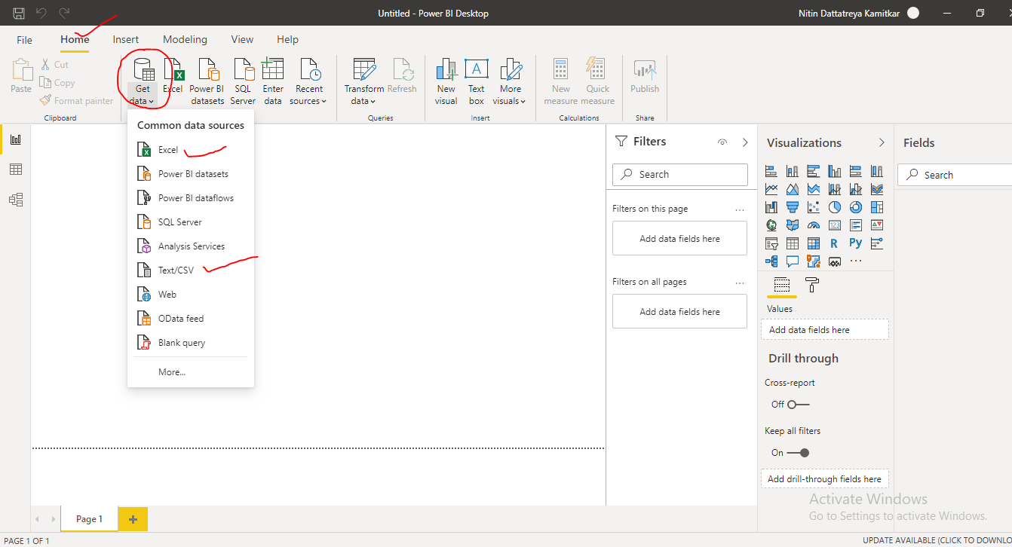
Step 1. To import data click on get data option which available on home tab and select file type.

Slide 14
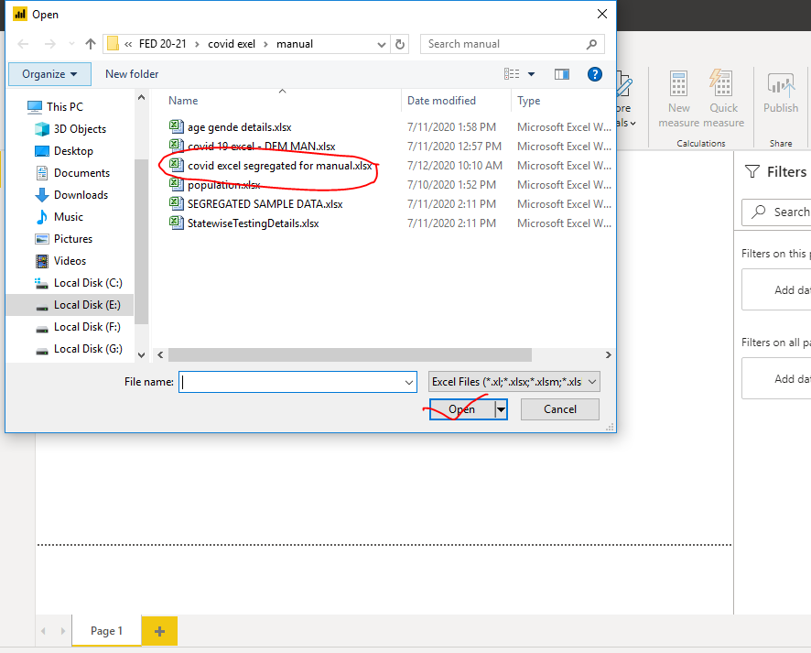
Click on type of file and it will ask location from which file to be uploaded. Now select the file and click on open.

Slide 15
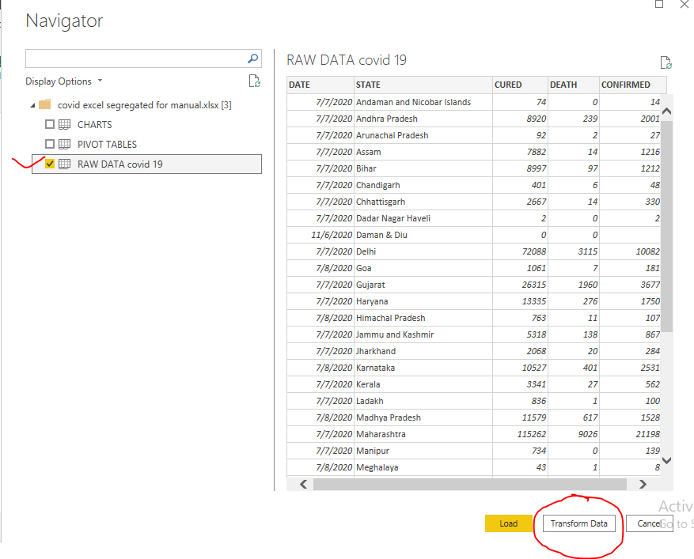
After clicking open, Navigator popup which will ask to select particular sheet from the sheet. Select raw data and click on transform data.

Slide 16
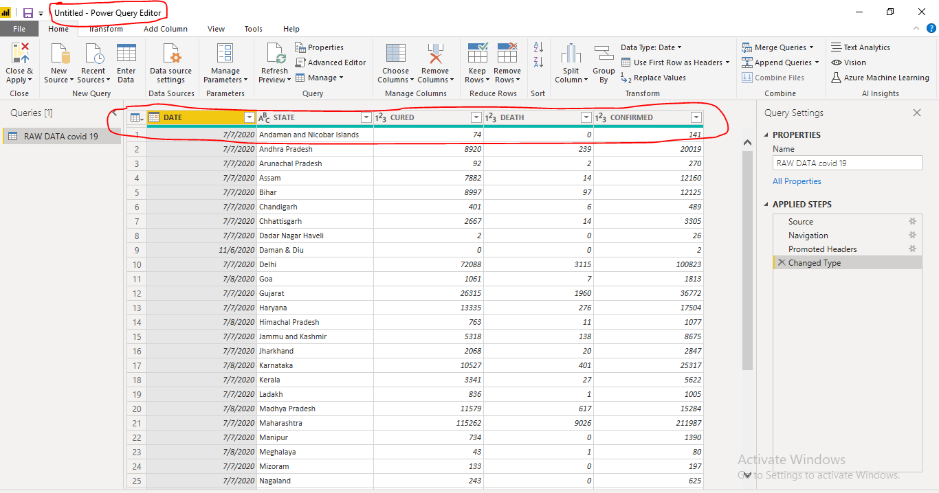
After clicking on transform data we will get window called power query editor in which we can manipulate data. Check all data are visible or not and edit if required only.

Slide 17
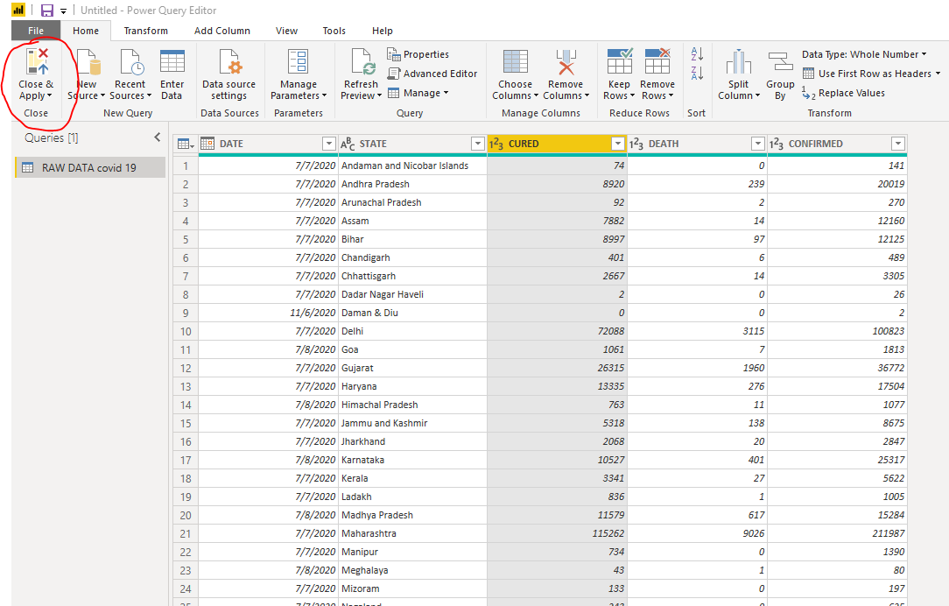
Once edit or transforming has done then click on close and apply button from left fop corner which is mandatory to apply the changes made in data.

Slide 18
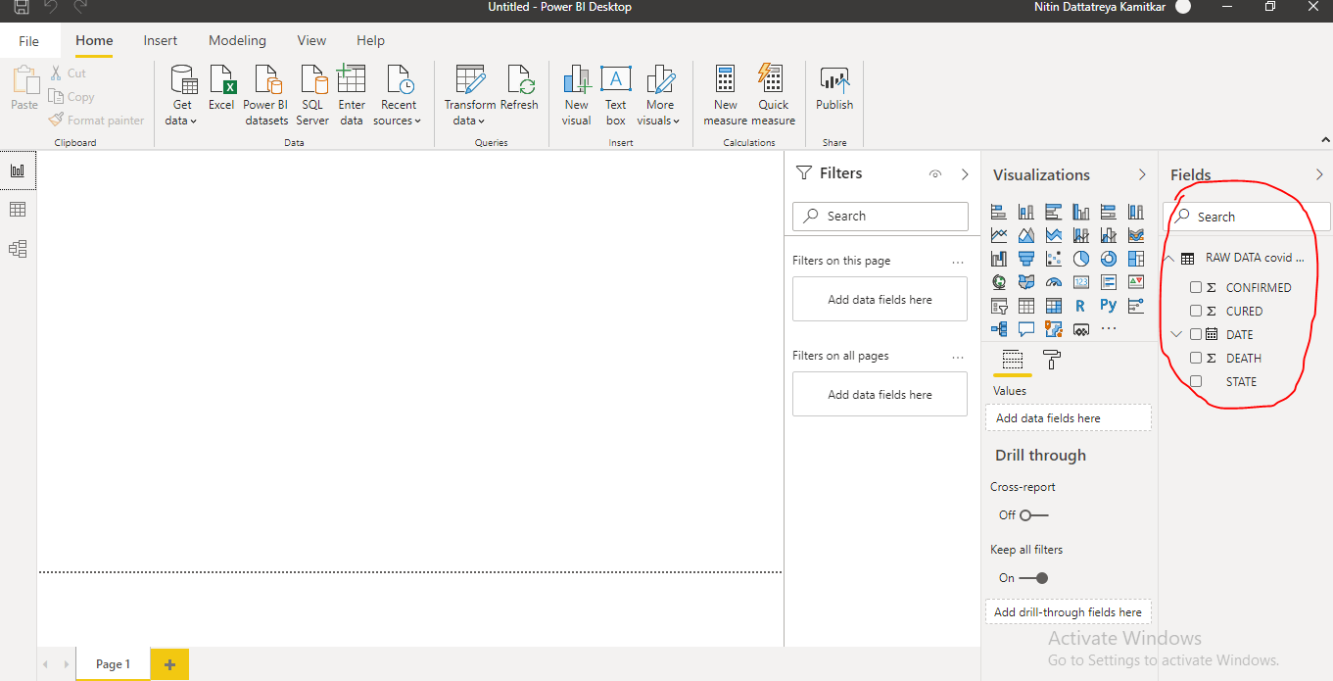
Ensure all information is imported properly or not from right side fields.

Slide 19
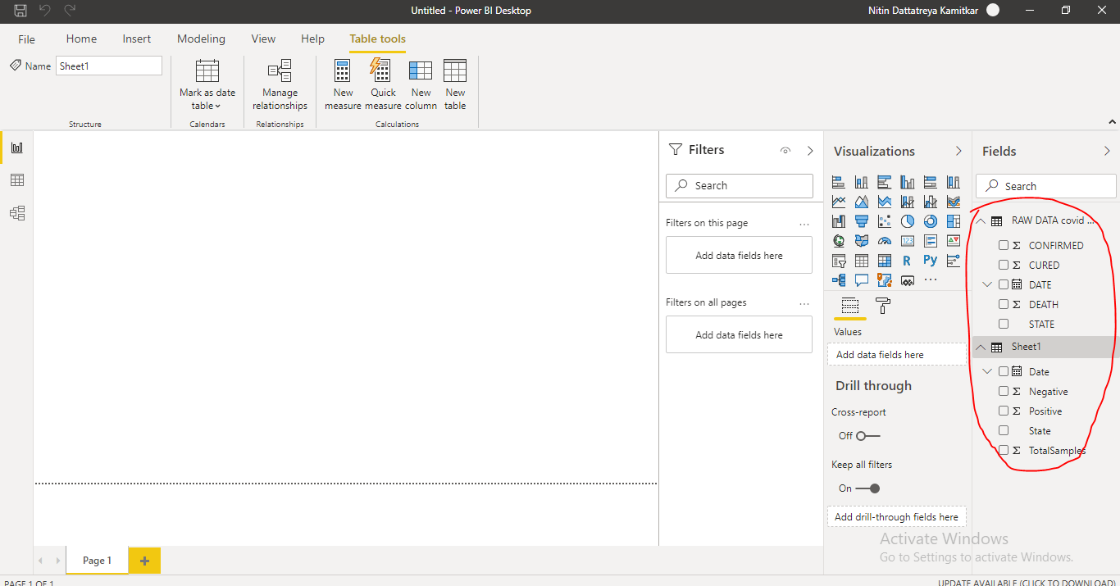
Repeat the steps 6-10 to import another set of data consisting sample details.

Slide 20
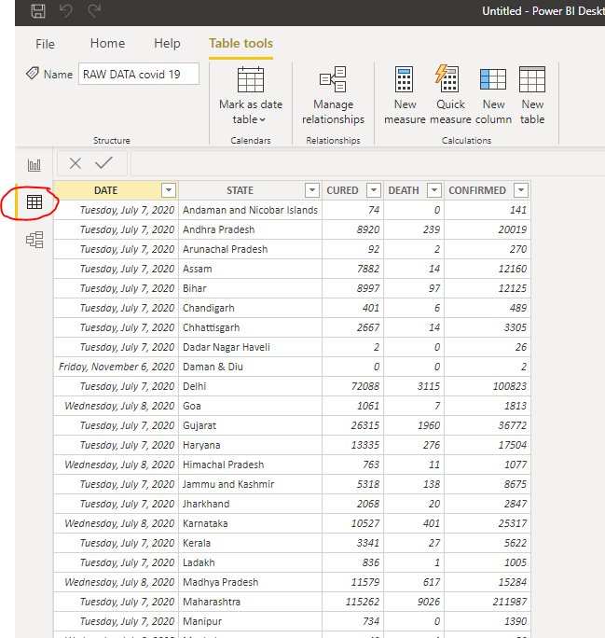
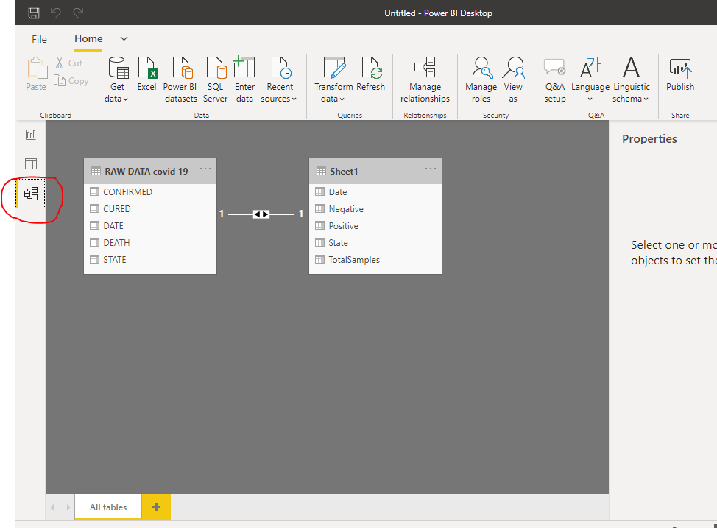
Check data and modeling of sheets as shown in figure.

Slide 21
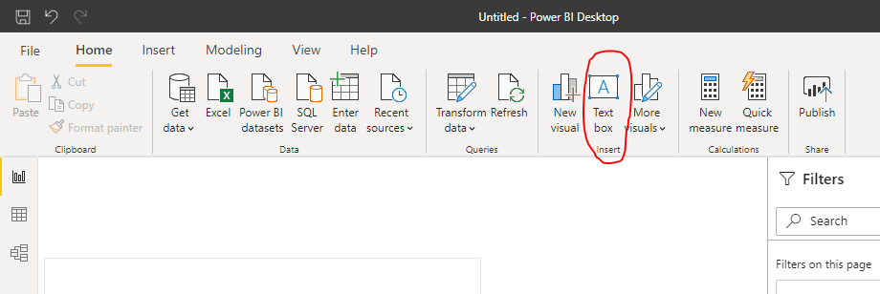
Now the POWER BI engine is ready to create dashboard. Initially name the dashboard “ COVID 19 DETAILS INDIA”. By selecting put text box and restyle it as per requirement.

Slide 22
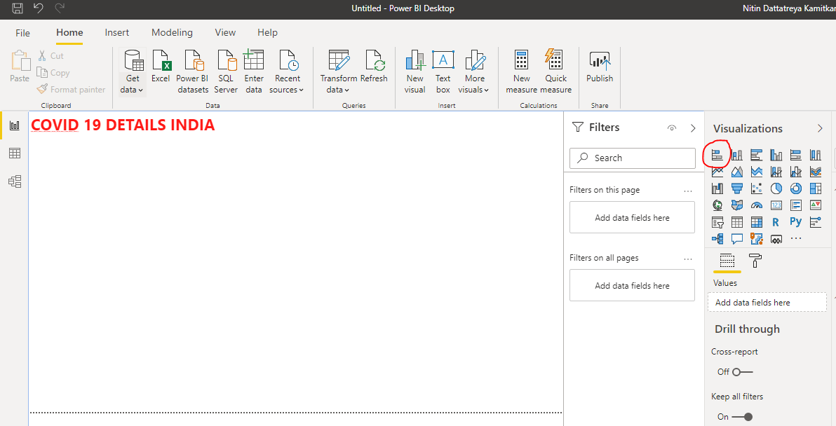
Now put bar chart for state wise confirmed chart by using bar charts by clicking on visualizations .

Slide 23
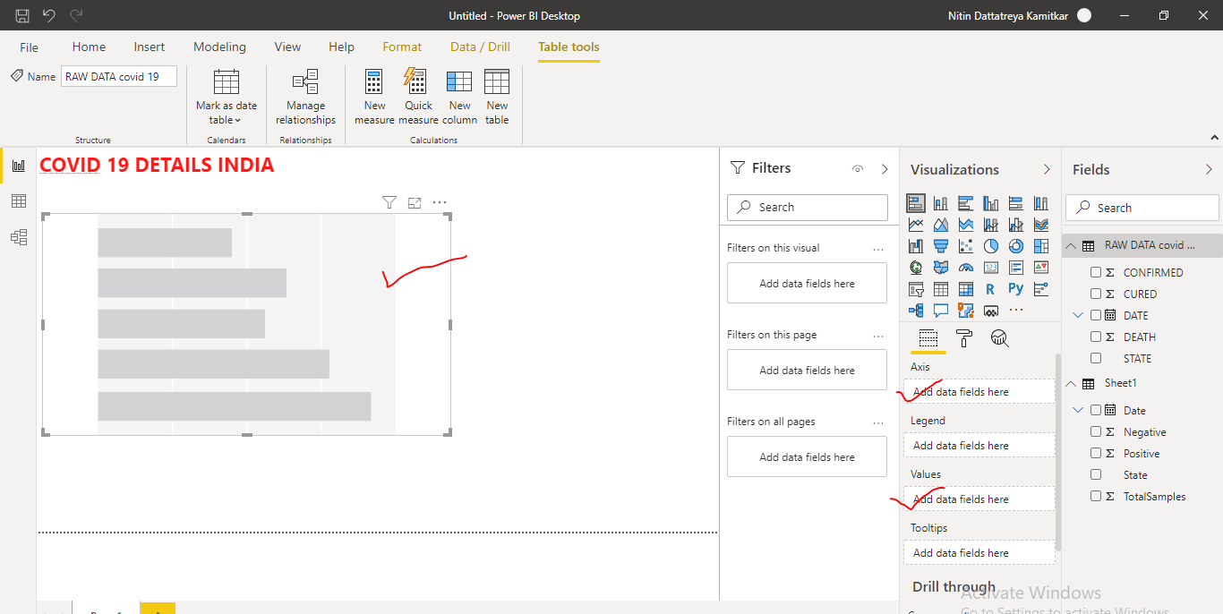
Now on the dashboard we have blank bar chart with fields to be assigned.

Slide 24
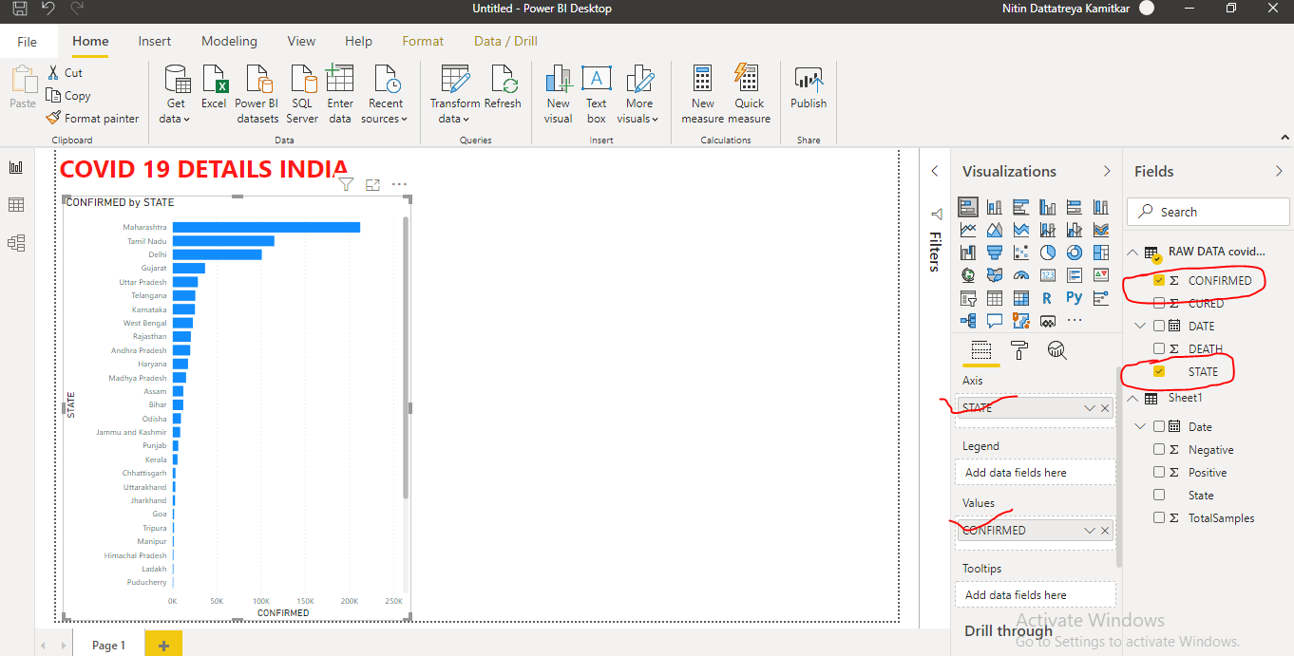
Here one parameter is state another parameter is confirmed cases. Select on state and select on confirmed tab as shown below.

Slide 25
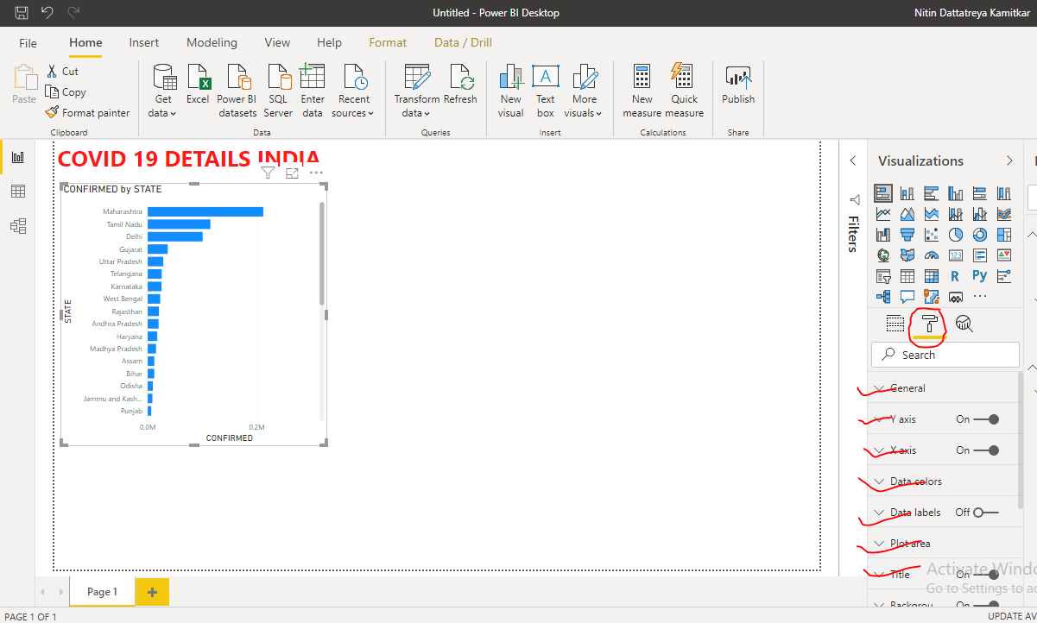
To edit this plot style click on format. Now we have many options to change chart style. Modify the chart as per requirement.

Slide 26
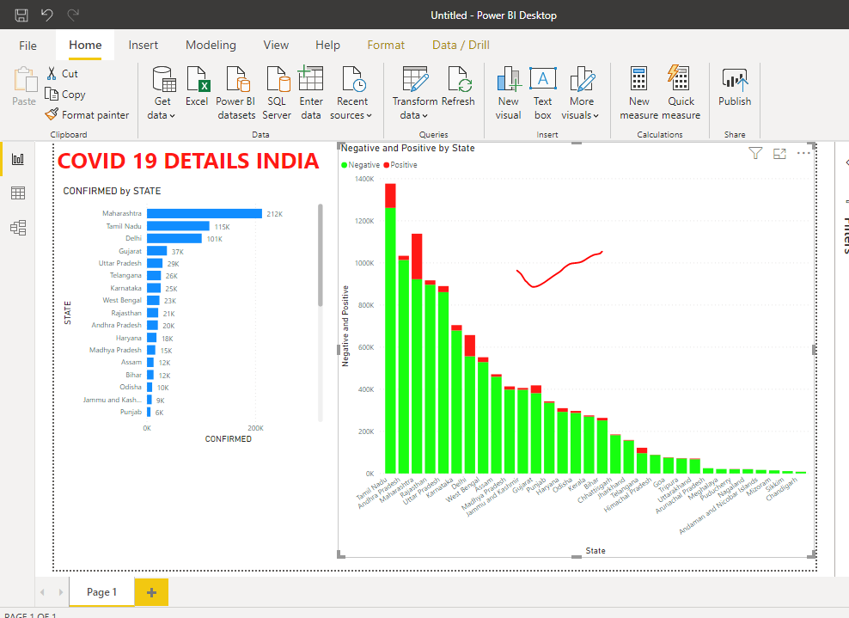
Now put the stacked bar chart from sheet 1 (sample details) to check positive and negative intensity state wise. And modify the chart.

Slide 27
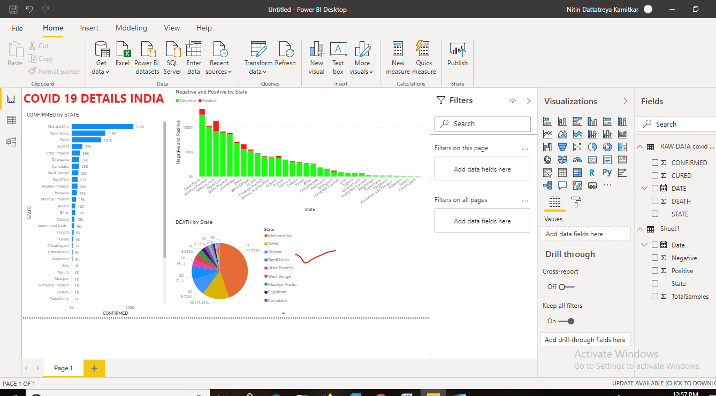
Now put pie chart to visualize death distribution by state.

Slide 28
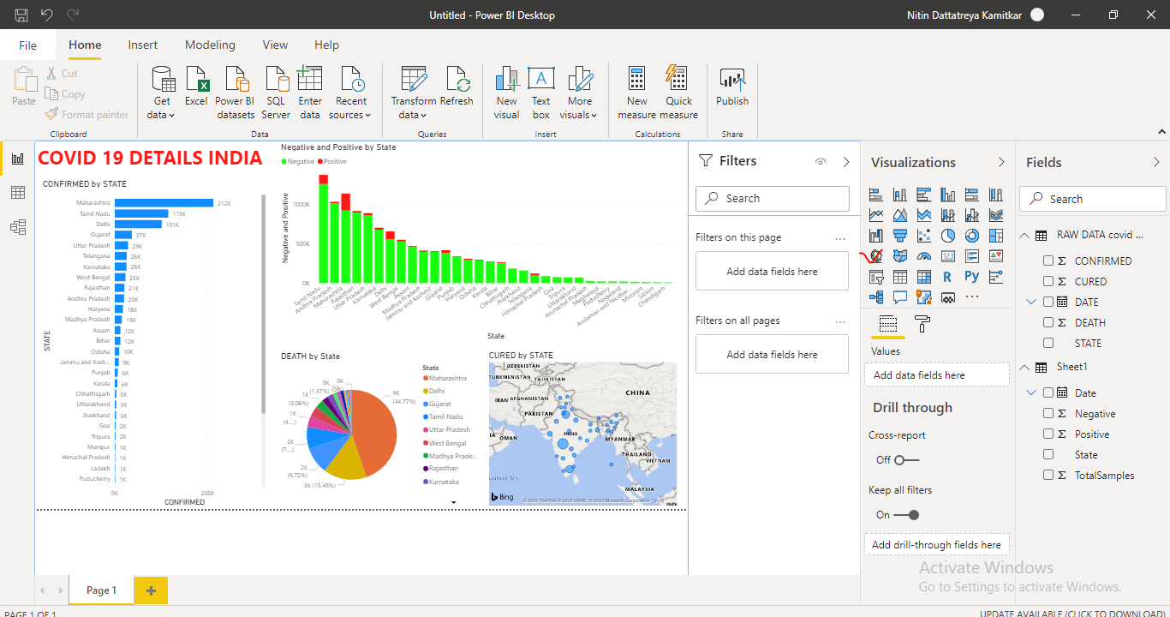
Put state wise cured map.

Slide 29
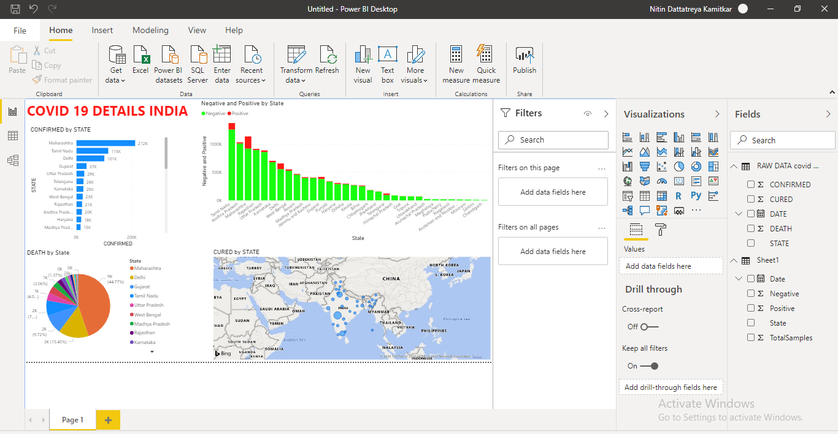
Interactive dash board is ready with 4 different visualizations.

Slide 30
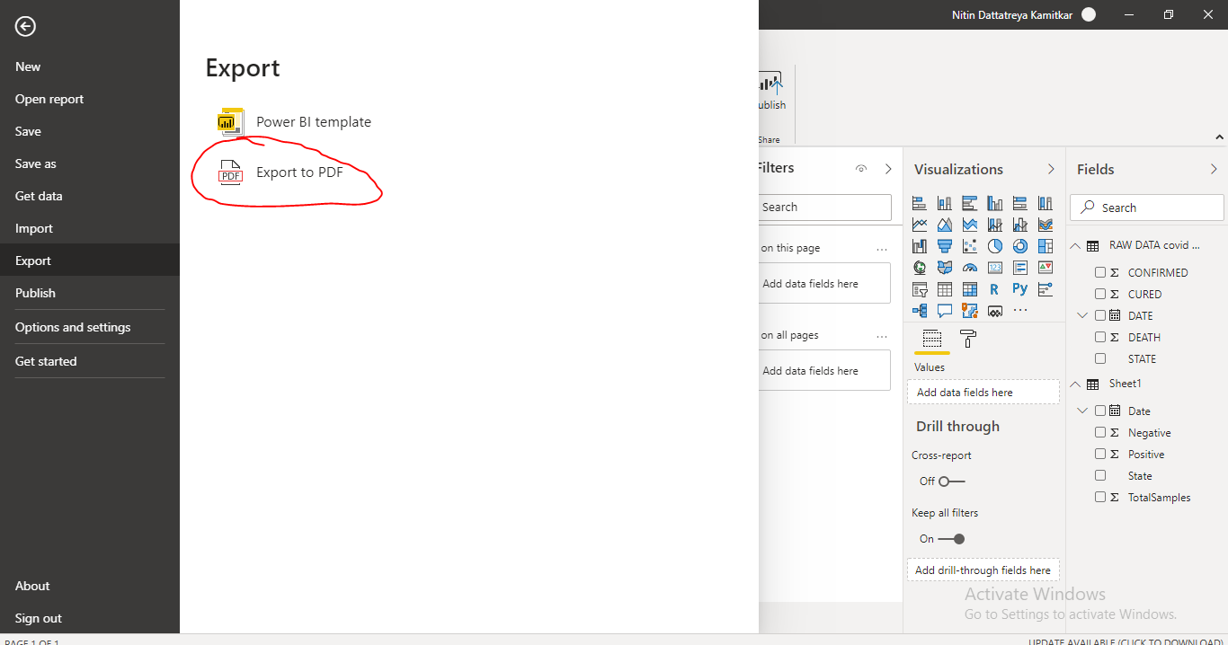
We can export this as pdf by clicking on file-export as –pdf.

